Slide 1


Ecommerce Customer Segmentation and Prediction
By Adarsh Kumar
CONFIDENTIAL: The information in this document belongs to Boston Institute of Analytics LLC. Any unauthorized sharing of this material is prohibited and subject to legal action under breach of IP and confidentiality clauses.

Slide 2
Agenda
Project Objective
Database Overview
Data Preprocessing
Exploratory Data Analysis
Correlation Analysis
Model Training
Model Evaluation
Conclusion

Slide 3
Project Overview
Objective: Enhance marketing strategies & customer retention for an e-commerce company.
Approach: Use machine learning to analyze purchasing patterns.
Key Outcomes:
Customer segmentation model
Predictive classifier for future purchasing behavior
Impact: Improve marketing, customer retention & inventory management.

Slide 4
Project Benefits
Enhanced Customer Segmentation
Identify & categorize customers based on purchasing behavior.
Enable personalized & targeted marketing campaigns.
Cost Efficiency
Focus marketing efforts on high-value customer segments.
Optimize resource allocation for maximum impact.
Improved Customer Satisfaction
Tailor offers & communication to customer needs.
Enhance customer experience & loyalty.

Slide 5
Data frame Observations
InvoiceNo: Unique identifier for each transaction
StockCode: Product code
Description: Product name
Quantity: Number of items purchased
InvoiceDate: Date and time of the transaction
UnitPrice: Price per unit of the product
CustomerID: Unique identifier for each customer
Country: Country where the transaction occurred

Slide 6
What is RFM Analysis?
Recency, frequency, monetary value is a marketing analysis tool used to identify a company's or an organization's best customers by measuring and analyzing spending habits.
What is Recency, Frequency, Monetary
Recency: How recently a customer has made a purchase.
Frequency: How often a customer makes a purchase.
Monetary Value: How much money a customer spends on purchases.
The concept of recency, frequency, monetary value (RFM) is thought to date from an article by Jan Roelf Bult and Tom Wansbeek, “Optimal Selection for Direct Mail,” published in a 1995 issue of Marketing Science. RFM analysis often supports the marketing adage that “80% of business comes from 20% of the customers.”

Slide 7
Insights
• Customer 12347 stands out as highly valuable with frequent purchases and high monetary contributions.
• Customers like 12346 exhibit very low engagement and spending, contributing very little to overall Customer Lifetime Value (CLV).
• Recency plays a significant role in determining active customers, as seen with lower recency values correlating with higher frequency and monetary contributions.

Slide 8
Data Preparation
• Handling outliers – Any outliers from numerical columns should be removed.
• Scaling the values – Because the numeric column have different scale, we need to scale it first, so all numeric value have difference
• Ready for modelling – The data frame is ready for modelling.

Slide 9
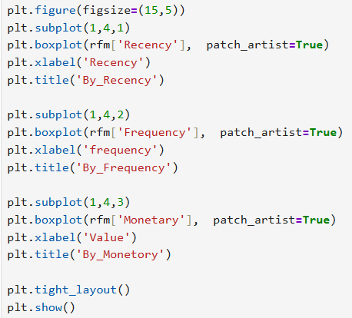
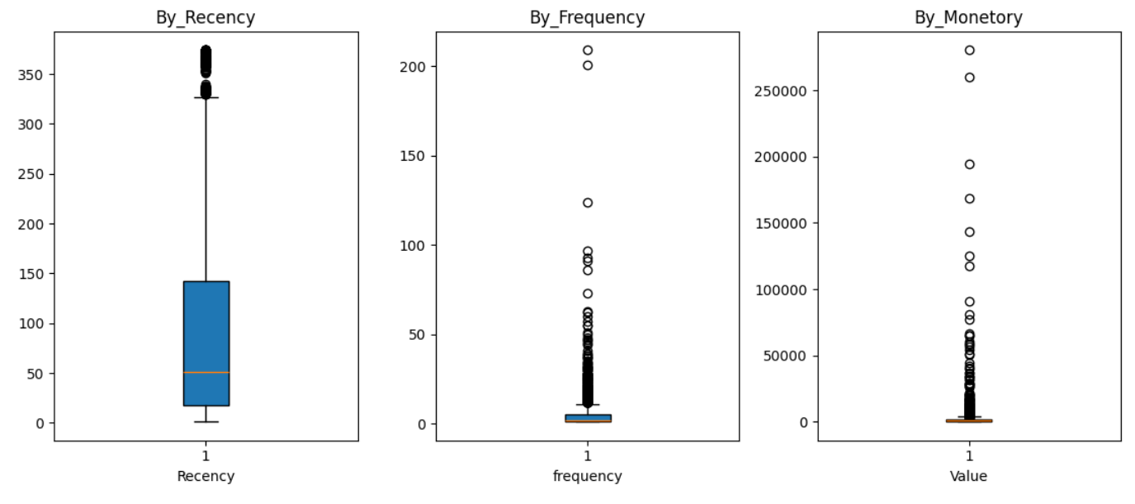
Handling Outliers
Creating Graph

Slide 10
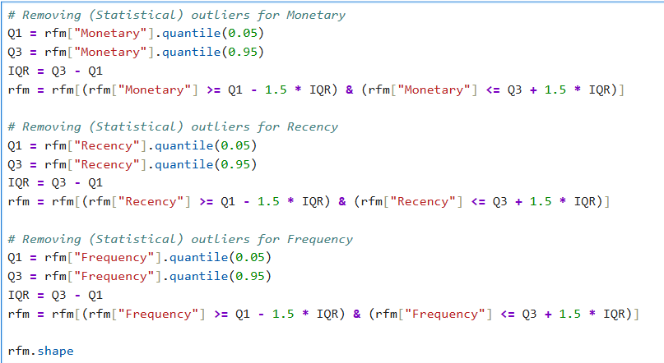
Handling Outliers
Removing Outliers

Slide 11
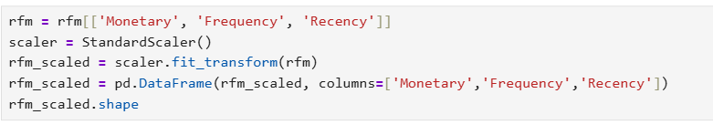
Scaling
Creating data frame with scaled values

Slide 12
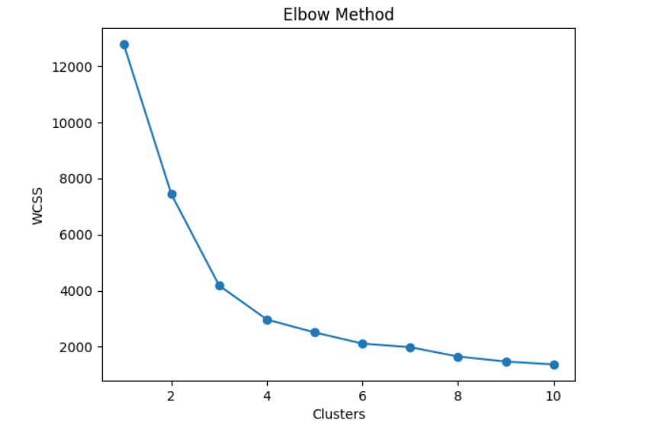
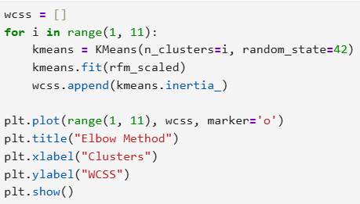
Elbow curve for K-Means

Slide 13
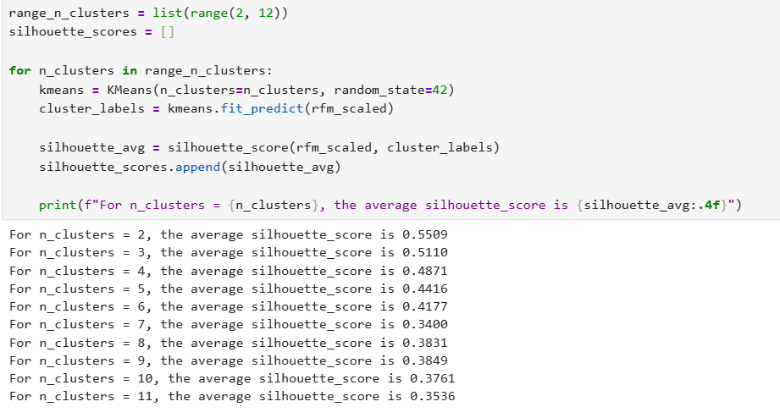
Silhouette Score

Slide 14
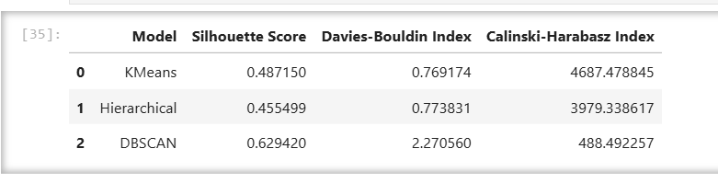
Customer Segmentation
Different clustering methods are used, such as K-means, Hierarchical clustering, DBSCAN clustering, etc
Out of these, K-means clustering was chosen for segmenting the customer because it is simple, efficient, and scales well to large datasets.

Slide 15
Insights for cluster to improve the Business
High-value customers: Offer loyalty, programs and exclusive discounts.
Recent but low-frequency customers: Send personalized recommendations.
Inactive customers: re-engage with special offer and reminders.

Slide 16
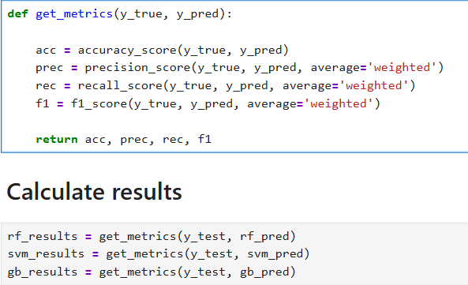
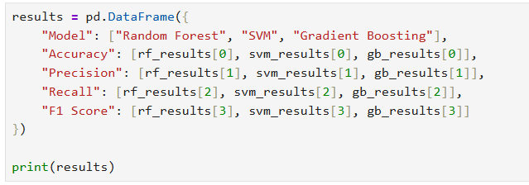
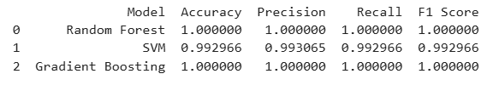
Performance Summary:
Random Forest: 1.00% accuracy.
SVM: 99.29% accuracy
Gradient boost: 1.00% accuracy
Metrics Used:
Precision: Model’s ability to predict the cluster correctly.
Recall: Sensitivity to capture all true positives.
F1-Score: Balance between precision and recall.

Slide 17
Conclusion
I. Customer Value Segmentation
I. Identify high-value customers for loyalty programs and exclusive offers. II. Encourage medium-value customers to increase spending through personalized recommendations. III. Re-engage low-value customers to boost purchasing frequency. IV. Optimize inventory management and plan targeted marketing campaigns based on purchasing patterns.
II. Behavioral Patterns
I. Analyze recency, frequency, and monetary value to identify active, loyal, and high-spending customers for targeted marketing efforts.
III. Predictive Insights
I. Use predictive models to forecast customer segments, enabling proactive marketing and retention strategies.
IV. Inventory Optimization
I. Optimize inventory management by understanding top-selling products and purchasing patterns to keep popular products in stock and reduce overstock.
V. Marketing Efficiency
I. Improve marketing efficiency by tailoring campaigns based on customer segments, ensuring resources are allocated to the most promising groups.

Slide 18
Conclusion
• Implemented K-Means Clustering for customer segmentation. • Random forest Classification to predict customer categories.
K-Means Clustering: • Optimal Number of Clusters: 3 (Loyal Customers, Recent Customers, At-Risk Customers). • Metric Used: Davies-Bouldin Index = 0.76.
Random Forest: • Accuracy: 1.00%.
Business Impact: • High-Value Customers: Offer loyalty incentives. • Mid-Range Customers: Nurture into premium segments. • Low-Engagement Customers: Launch reactivation campaigns.

Slide 19
Recommendations
Beside the campaign, company should doing analysis for the customers’ habit, this can be improving ads, product recommendation and promotion for customers.
To bring back the customers who have left, company needs to consider to start the campaign by giving them promo as promo campaign with certain payment method or specific payment gateway/provider. This campaign can be focused on “Dolphin let you miss you” and “It’s been a While” customers.
For “Let Minnow” customers, campaign to boost the spending amount and to keep them stay with the platform is strongly recommended. Such as cashback promo or rewarding referral can be the option for the campaign.

Slide 20
Questions ?

Slide 21
Thank You!
CONFIDENTIAL: The information in this document belongs to Boston Institute of Analytics LLC. Any unauthorized sharing of this material is prohibited and subject to legal action under breach of IP and confidentiality clauses.

